Slide 1
Final project Presentation Brain Tumors Detection
11-09-2022
CS584 – Mouhammad BAZZI
A20522180
Fall 2022

Slide 2
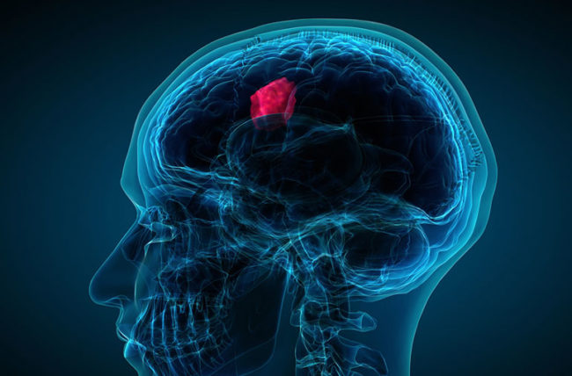
Problem Description
2
Brain tumors are responsible for 90% of all primary Central Nervous System malignancies.
To diagnose brain tumors we use Magnetic Resonance Imaging (MRI).
Sometimes hard to detect because of the complexity of brain tumors and their characteristics (size, localization, etc.).
https://health.clevelandclinic.org/wp-content/uploads/sites/3/2020/02/brainTumor-475447149-770x533-1-650x428.jpg

Slide 3
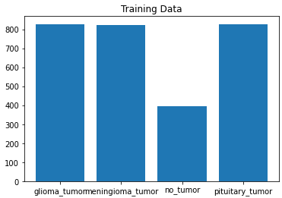
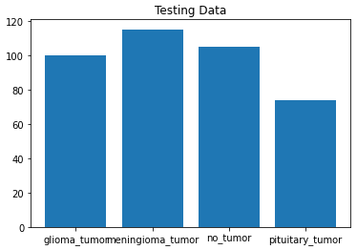
Data Set Presentation
3
Data from Kaggle | Different types of MRI images | Different images sizes | 4 different classes
Total number of training images: 2870
88% of the entire dataset
Total number of test images: 394
12% of the entire dataset

Slide 4
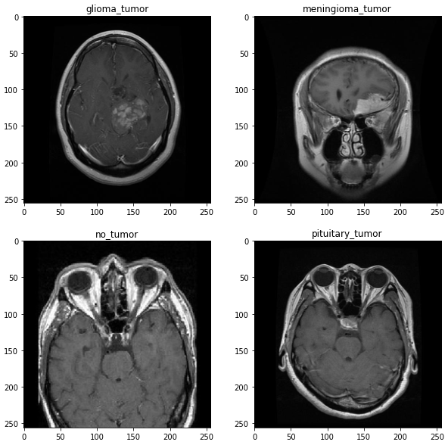
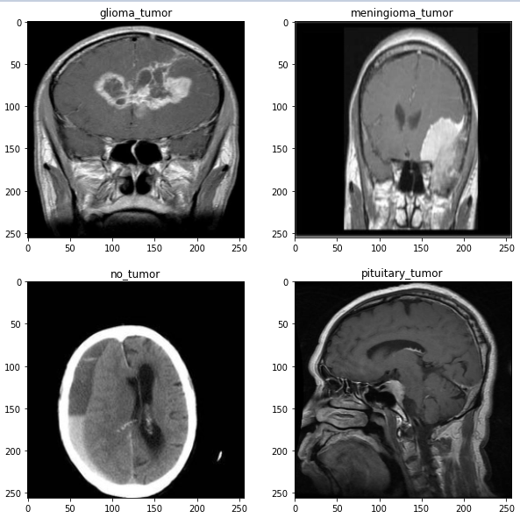
Data Set Presentation
4

Slide 5
Data Pre-processing
5
Shuffle Data
Separate Labels from features (image)
Dividing in validation and training dataset
Normalizing features (image)
One-hot encoding labels

Slide 6
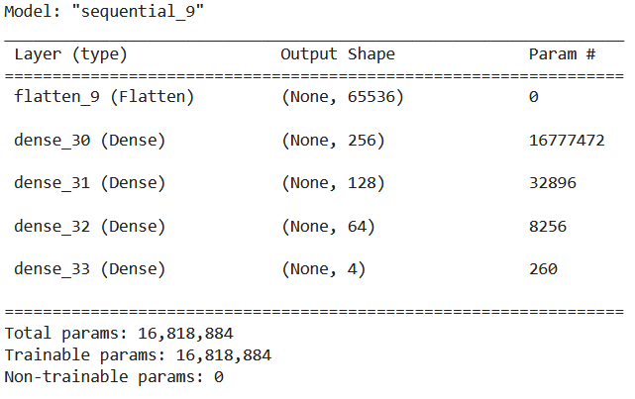
First Model - ANN
6

Slide 7
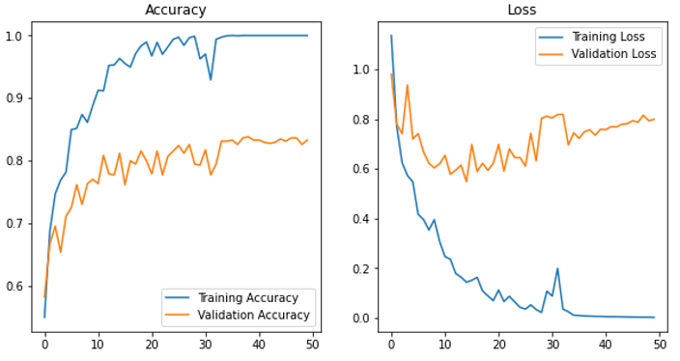
First Model - ANN
7
Adam Optimizer (learning rate : 0.0005) ; Categorical Cross-Entropy ; Batch_size of 32
Test accuracy: 75,63%

Slide 8
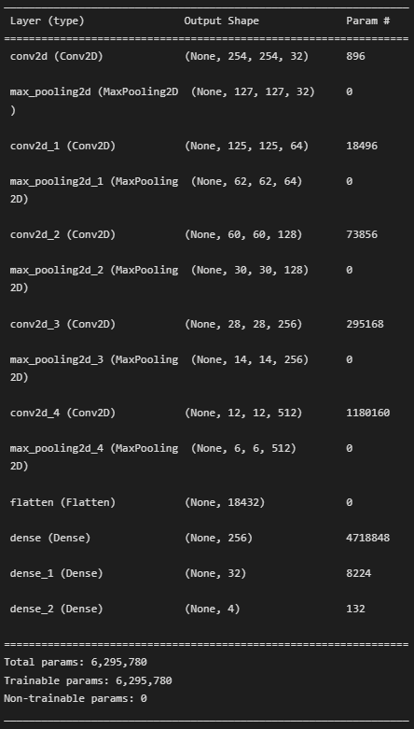
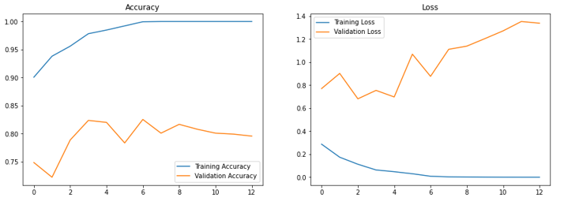
Second Model - CNN
8
RMSprop Optimizer (learning rate : 0.0008) ; Categorical Cross-Entropy ; Batch_size of 64
Test accuracy: 76,24%

Slide 9
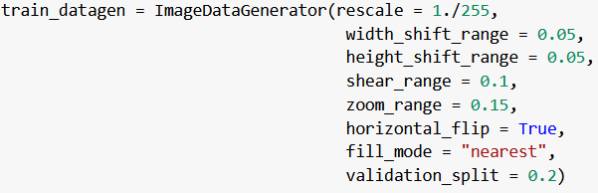
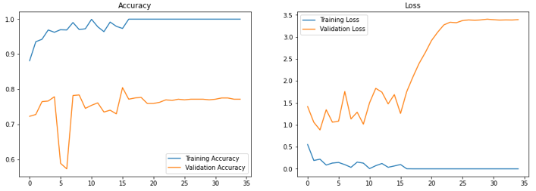
Third Model – CNN with Data Augmentation
9
Test accuracy: 79,14%

Slide 10
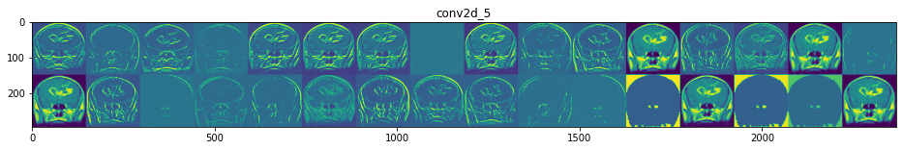
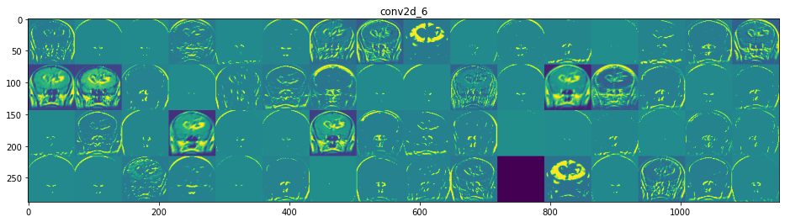
Visualizing the CNN
10

Slide 11
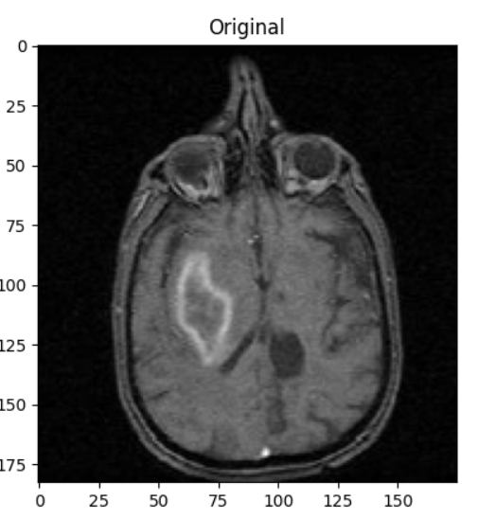
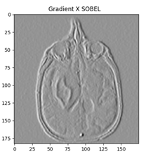
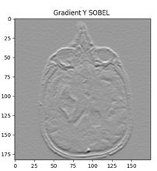
Next Steps
11
Continue to tune the Convolutional Network
Try to change the pre-process data by applying a filter on the MRI images to take advantage of the domain knowledge:
For example the Sobel Filter:

Slide 12
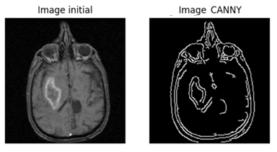
Next Steps
12
Canny Filter:
If I have time: try other CNN architecture

Slide 13
Thanks for your attention
13

